Slide 1
Electrical Hazard

Slide 2


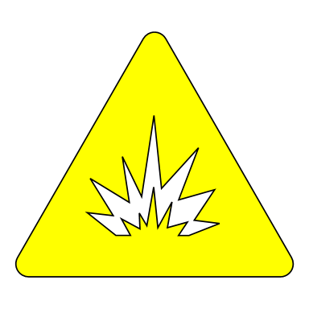
Electrical Hazard
Potential event or situation when electrical energy can cause injury or damage to property.
Shock
Arc
Explosion

Slide 3
Shock
Effect of electric current on human body.
Magnitude | Effect
10 mA | Painful sensation
30 mA | Respiratory paralysis
75 mA | Heart fibrillation
4 A | Heart paralysis without fibrillation
5A | Tissue burning
Physical stimulation when electric current passes through the human body.
Effect depends on both magnitude and duration of current. However beyond a threshold magnitude has more prominent effect.

Slide 4
Procedural Strategy to prevent shock
De-energize all circuits and conductors in the immediate work area.
Develop and follow a lockout/tagout procedure.
Maintain a safe working distance from all energized equipment and conductors.

Slide 5
Equipment Strategy to prevent shock
Equipment body Insulation
Mats, sleeves, cable terminations
Insulated tools, gloves.
ELR, ELCB, RCCB.
Proper grounding.

Slide 6
Arc ----------- Ignition of air.
When voltage between two points exceeds dielectric strength, arc is produced due to breakdown of air.
When energized contact is broken arc is created due to inductive flywheel effect.
When a conductor gets superheated, surrounding air ignites.

Slide 7
Effect of arc.
Types of skin burn due to electric arc.
First degree burn | Damage limited to outer layer only. Skin growth centers are not affected. Fully recoverable and no permanent scarring.
Second degree burn | Entire outer layer is destroyed. Skin growth centers are affected but healing can start from sweat glands/ hair follicles.
Third degree burn | Complete destruction of growth centers. Requires skin grafting.
Electric arcs are extremely hot which can cause burns when present in the surrounding area.
Energy in electric arc depends upon power rating of the system. Low voltage arcs are as lethal as high voltage arcs.

Slide 8
Procedural strategy for electric arc.
Suitably rated equipment.
Regular watch for loose connection.
Correct connection and disconnection sequence.
Dirt and moisture free contacts.

Slide 9
Equipment strategy for electrical arc.
Gloves and goggles.
Overload protection.
Short circuit protection

Slide 10
Explosion
Rapid expansion of air carrying high energy projectiles.
Most often an arc is the primary reason of an explosion.

Slide 11
Procedural strategy for explosion
Suitably rated equipment.
Periodical inspection of equipment for any sign of abnormality.
Correct connection and disconnection sequence.
Dirt and moisture free equipment.
Safe distance while being energized.

Slide 12
Equipment strategy for explosion
Short circuit protection.
Sensing devices for monitoring of accumulation of flammable gas.
Lightening protection.

Slide 13

Thank You

